Slide 1

ACADEMIA INTERNATIONAL COLLEGE
Website on – Chhaana “The Restaurant”
Presented By : Presented To :
Rinka Maharjan (21) Mr. Shambhu Charan Shrestha
Sachana Maharjan (24) Department of IT
Sesema Limbu (27) Academia International College
Sresta Sharma (31)
BSc.CSIT 1st sem

Slide 2
INTRODUCTION
Generally, an establishment where the public may obtain meals or refreshments.
Serves a larger role in the society.
Have become places of social contact and of discovering new cultures and tastes.
Website making easier for better reach out to and for people.

Slide 3
ABOUT ORGANIZATION
“Chhaana”
Authentic Newari restaurant.
Serving its real essence.
Highly Affordable.
Located at an easily accessible place – Gwarko, Lalitpur.

Slide 4
PROBLEM DESCRIPTION
Missing out on a massive audience.
To provide brand image.
To reach out to many people.

Slide 5
PROJECT OBJECTIVE
To create a user friendly website.
To help the users in exploring more about the restaurant.
To attract customers through a pleasant presentation of the restaurant.

Slide 6
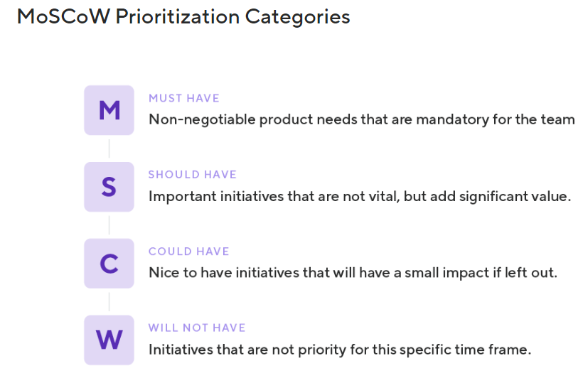
METHODOLOGY
Agile MoSCoW Prioritization Method.
Popular prioritization technique.
For managing requirements.

Slide 7
IMPLEMENTATION
Hardware :
Memory - 2 GB of RAM
Display - Super VGA with a resolution of 1024 * 768
Processor - 1.9 GHz x86 or x64 - bit dual core processor with SSE2 instruction set
Software :
Html 5, CSS 3, JS 1.7, Bootstrap 5

Slide 8
SCOPE
Responsive and User-friendly.
WCAG 2.0 AA Standard.
Use of Ganttchart.
Bootstrap Implementation.

Slide 9
OUT OF SCOPE
No online ordering.
No sign-in options.
No provision of review and ratings from user.

Slide 10
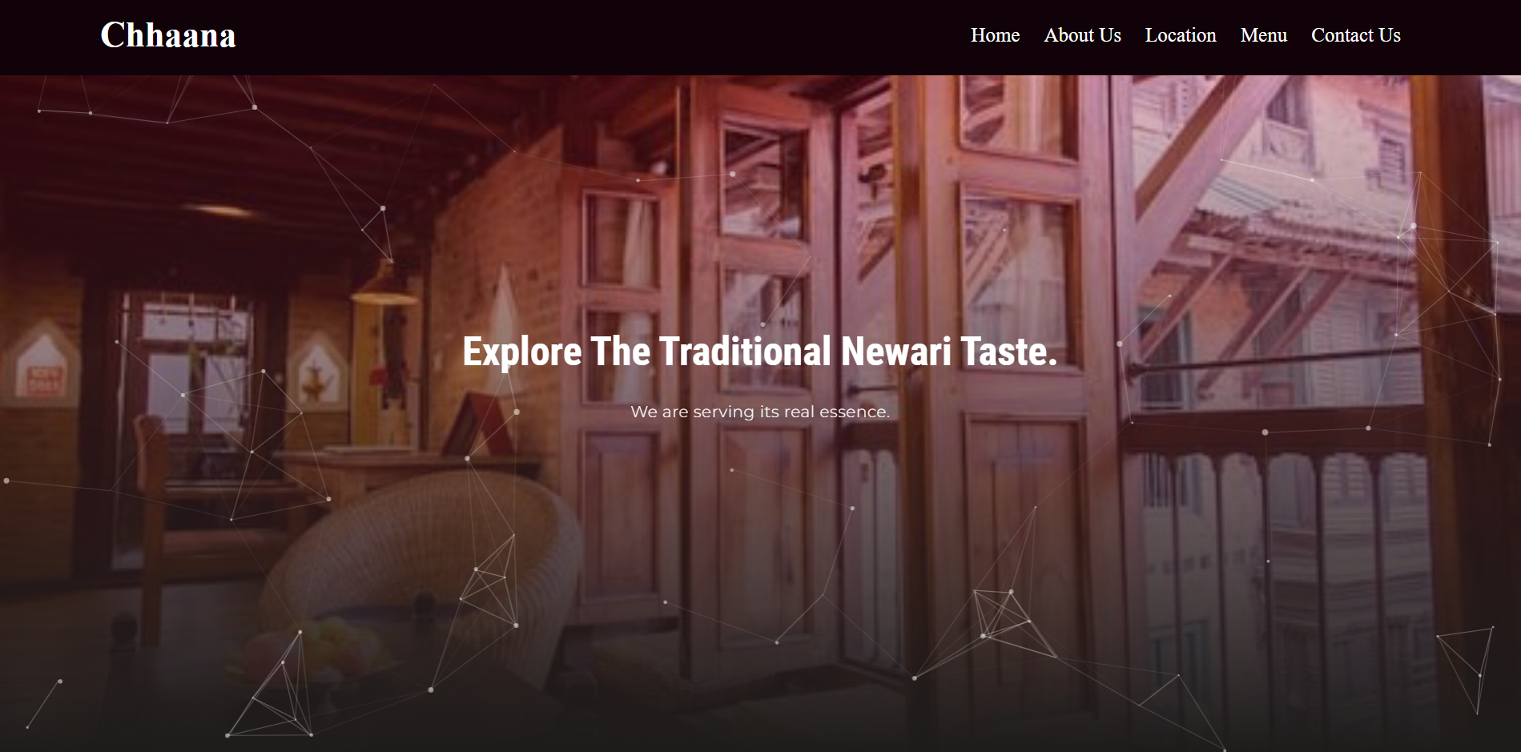

Slide 11
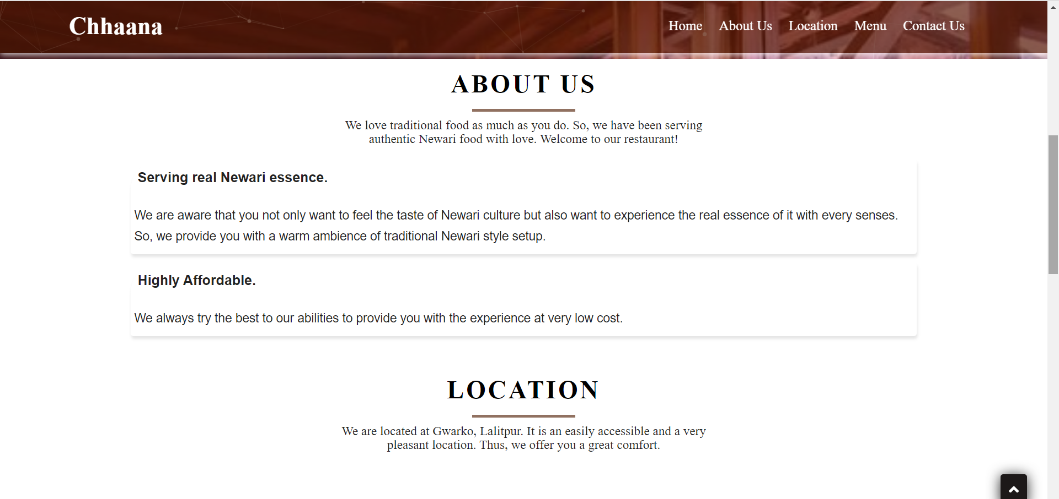

Slide 12
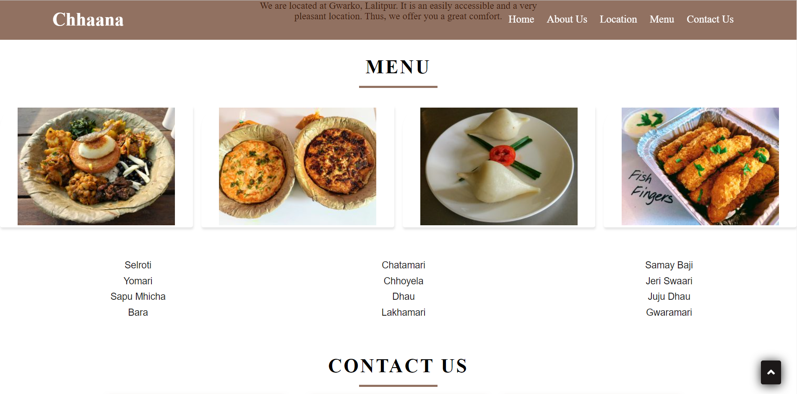

Slide 13
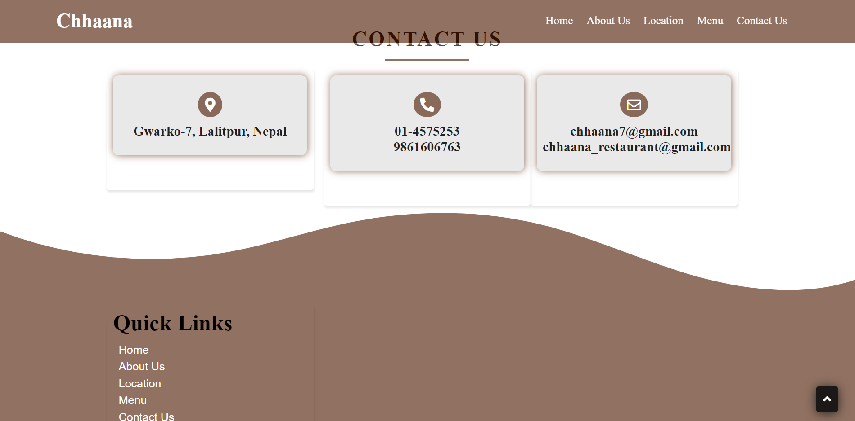

Slide 14
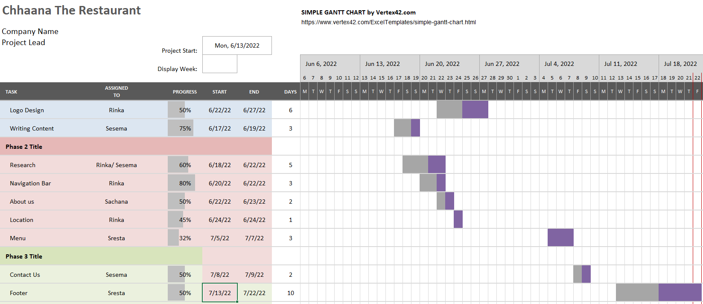

Slide 15
OVERVIEW OF SYSTEM
has provided the users with a general introduction about the restaurant.
made as user-friendly as possible.
with a belief of helping in attracting customers.
thus, enhancing the business.

Slide 16

“Any feedback will be highly appreciated.”

